Slide 1
Syncsort Data Integration Update
05.28.2013

Slide 2
Summary
Helping Data Intensive Organizations Across the Big Data Continuum
Hadoop – The Operating System for Big Data
Strategic Focus on Hadoop & Collaboration with Open Source
Patch New Feature Commitment
Spring ‘13 Release – Delivering a Smarter Approach to Hadoop ETL with 2 New Offerings:
DMX-h ETL Edition
DMX-h Sort Edition
Closing Thoughts
Delivering Better ETL through Hadoop & Better Hadoop with Enhanced ETL Capabilities

Slide 3
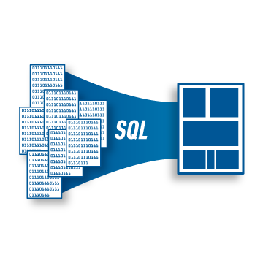
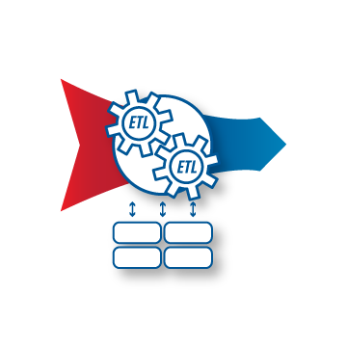
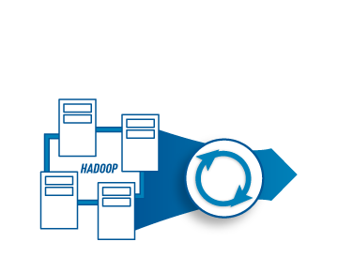
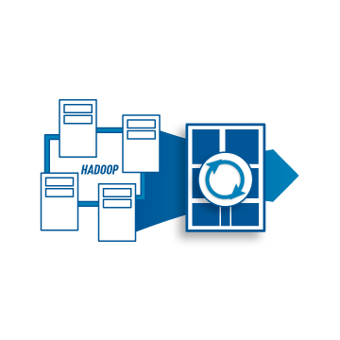
The Big Data Continuum
Min
Value
Max
Awakening
Advancing
Plateauing
Dynamic
Evolved
Big Data Continuum
Hand-coding:
SQL, JCL
Standardization & platforms for enterprise connectivity
Arch limits + exponential costs. Growing MIPS, missed SLAs
Early Hadoop adoption
prototyping & experimentation
Big Data is the new standard for both MF & open systems data
Hand-coding nightmare
Long development cycles
Unsustainable costs
Hadoop ingestion & usability gaps
Efficiency, ETL & skills gaps
Challenges
High-performance ETL
ETL & Rehosting Optimization
Hadoop Sort & ETL
Hadoop Sort & ETL
SQL Migration
Integrating Big Data… Smarter
DMX
DMX-h
MFX

Slide 4
Hadoop – The Operating System for Big Data
- ETL -
- Databases -
- Analytics -
(Casandra, HBase)
(Mahout, Datameer)
Describe & Develop
(Hive, Pig, HCatalog)
- Hadoop -
Monitor / Admin
(Zookeper, Oozie)
Persist
(HDFS)
Ingest / Propagate
(Flume, Sqoop)

Slide 5
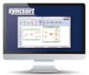
Syncsort DMX-h: Introducing Two New Hadoop Offerings
DMX-h ETL
Everything you need to turn Hadoop into a feature-rich ETL Solution
GUI for developing & maintaining MR jobs
Test & debug locally in Windows; deploy on Hadoop
Use-case Accelerators to fast-track development
Broad based connectivity with automated parallelism
Best in class mainframe data access
Improved per node scalability and throughput
DMX-h Sort
Seamlessly Optimize Map-sort and Reduce-merge Operations
Improved Hadoop Sort performance
Sort-work compression for storage savings
Support for native Hadoop data types & Hive queries
Automated deployment

Slide 6
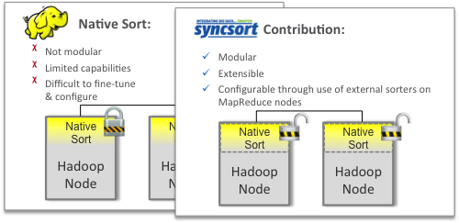
Strategic Focus on Big Data & Hadoop
JIRA:
2454
4808
4809
4812
4842
4482
and more!
1. Smart Contributions to the Open Source Community
2. Embrace Syncsort Technology Differentiators & Mainframe Heritage
Single install. No 3rd party dependencies
Light footprint
Self-tuning engine
Files & Mainframe Expertise
3. Strengthen Partnerships with Strategic Big Data & Hadoop Players
4. Leverage Customer’s Hadoop Expertise

Slide 7
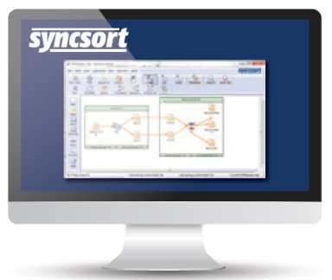
Syncsort DMX-h: Smarter ETL through Hadoop
Smart architecture with engine running natively within MapReduce framework
Smart connectivity delivers faster loads/extracts to HDFS
Smart development hides complexity of MapReduce
Smart use-case accelerators to jump-start Hadoop developer’s productivity
PLUS Smarter Hadoop…
Enhanced vertical scalability
Smart contributions to open source community

Slide 8
Syncsort Spring ‘13 Release
Smart architecture
DMX-h Sort & ETL product offerings
Performance improvements
Smart reformatting
Kerberos security authentication
HDFS Load/Extract, ETL execution
Smart development
Support for Job, all transformations
Graphical UI for development and debug
Smart use-case accelerators
Documented templates for common use cases (CDC, web log aggregations, Join, Lookup, mainframe, etc.)
Smart connectivity
Native connectivity including mainframe & DBMS’s
Ecosystem
“OpenSync” Phase I
Data Connector API
Spring ’13
Release
Announced May 20, 2013

Slide 9
Closing Thoughts
Gaining insights from Big Data is becoming a required business competency
Syncsort’s sort technology can become a standard Hadoop component
Big Data is fundamentally different from “small data” and breaks traditional data management architectures
Syncsort’s unique integration and core processing engine provides a unique approach to supporting large scale ETL in Hadoop with disruptive TCO
Hadoop is emerging as the operating system for Big Data management
Recent contributions to open source & new Hadoop centric offerings will deliver better ETL through Hadoop while strengthening Hadoop with ETL
ETL will be the killer app that drives adoption of the new OS

