Slide 1
MarkLogic 5 MarkLogic 5 is a next generation database designed for Big Data applications to deliver better decisions faster.

Slide 2
MarkLogic at a Glance
The biggest unstructured databases in the world run on MarkLogic
Flagship product is a next generation database for Big Data
A decade of experience in solving critical Big Data problems
Offices in Silicon Valley (HQ), New York, London, Washington DC, Tokyo, Frankfurt & Austin
Notes:
2

Slide 3
How did MarkLogic get here?
Founder
Christopher Lindblad MIT  InfoSeek  Inktomi
CEO
Ken Bado Mentor Graphics  Autodesk
Investors
Sequoia Capital  Tenaya Capital
Product
Database  Search  Web Application Technology  Big Data
Markets
Financial Services  Government  Information & Media  Healthcare
Customers
275+
Employees
260+ today  hiring 100 – 150 in 2012

Slide 4
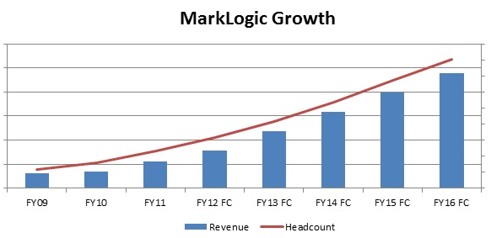
MarkLogic Financials and Headcount

Slide 5
You Have a Big Data Problem When
It is cost prohibitive to analyze all valuable data
You are duplicating data for different system needs
It takes more than two days to get new data in the system
Adding functionality takes more than two weeks
The lineage of reference data is uncertain
Signs:
Total cost of ownership becomes unmanageable with complexity and scale

Slide 6
Financial Firms
What is my exposure to the next Lehman’s?
Is something happening that violates my model?
Is my communication consistent with regulatory guidelines?

Slide 7
Public Sector
Which areas are most volatile here?
Who is in this suspect’s network?
What are our enemies planning?

Slide 8
Publishing
Who is collaborating in my field?
How does Dodd Frank impact prior legislation?
What is the legal precedent for sovereign nation defaults?

Slide 9
Why MarkLogic?
Next Generation database designed for 21st century data management challenges
Flexible Data Model
Massive Scalability
Modern Indexing
Enterprise Grade
Load data as-is
Store one, none, or many schemas
Progressively enhance data
Support many systems from single database
Petabyte deployments
Linear scaling
Shared nothing architecture
Commodity Hardware
Real time
Inverted indexes support scalability
Index
Structure
Metadata
Full Text
Geospatial
Replication and disaster recovery
Advanced monitoring and management
Tiered Storage
REST Libraries
Security
Notes:
9

Slide 10
MarkLogic 5
Confidence at scale
Enterprise Big Data
Managing Complexity

Slide 11
Confidence at Scale
MarkLogic 5 completes multi-year enterprise hardening roadmap with:
Database replication
Point in time recovery

Slide 12
HA/DR Features of MarkLogic
Feature | Function | Benefit | Use Case
Database backup/restore | Make a backup of your database, then restore it | Recover from complete data loss | Disaster Recovery
Journal Archiving/Point-In-Time Recovery | Make a continuous backup; restore to a point in time, or to the point of failure | Recover from complete data loss; recover all your data, or recover to just before a Bad Thing happened | Disaster Recovery
Snapshot backup | Very fast backup using mirrored disk | Recover from complete data loss; take a backup in seconds | Disaster Recovery High Availability
Database rollback | Roll back to a point in time before a Bad Thing happened | Recover in seconds from human error or a rogue application | Disaster Recovery High Availability
Automatic Failover Using Shared-Disk Local-Disk | If a node fails, automatically failover to another node | Recover from failure of a data node in a cluster | High Availability
Flexible Replication (part of Replication option) | Maintain a hot copy of (part of) a database in another data center | Move parts of a database, parts of documents, closer to users for improved performance | Information Sharing
Database Replication (part of Replication option) | Maintain a hot copy of a database in another data center | Recover from loss of a Data Center | Disaster Recovery High Availability
Distributed Transactions | XA support for transactions that go across MarkLogic and other repositories | Keep an exact (synchronous) copy of your data in more than one place | Disaster Recovery High Availability Information Sharing

Slide 13
Enterprise Big Data
MarkLogic 5 seamlessly integrates into enterprise data centers with:
Tiered storage
Enhanced Monitoring and Management

Slide 14
Tiered Storage
MarkLogic 5 supports tiered storage allowing customers to optimize cost / performance tradeoffs
Solid State Disks
Fast Spinning disks
Slower spinning disks
Point MarkLogic 5 at your storage endpoints and we handle the rest

Slide 15
Monitoring and Management
Easily integrate MarkLogic into your enterprise IT operations
Key new features
Monitoring Dashboard
Monitoring and Management API
Configuration Manager
Plugin for Nagios
Smart Plug-in for HP Operations Manager

Slide 16
Plugin for Nagios

Slide 17
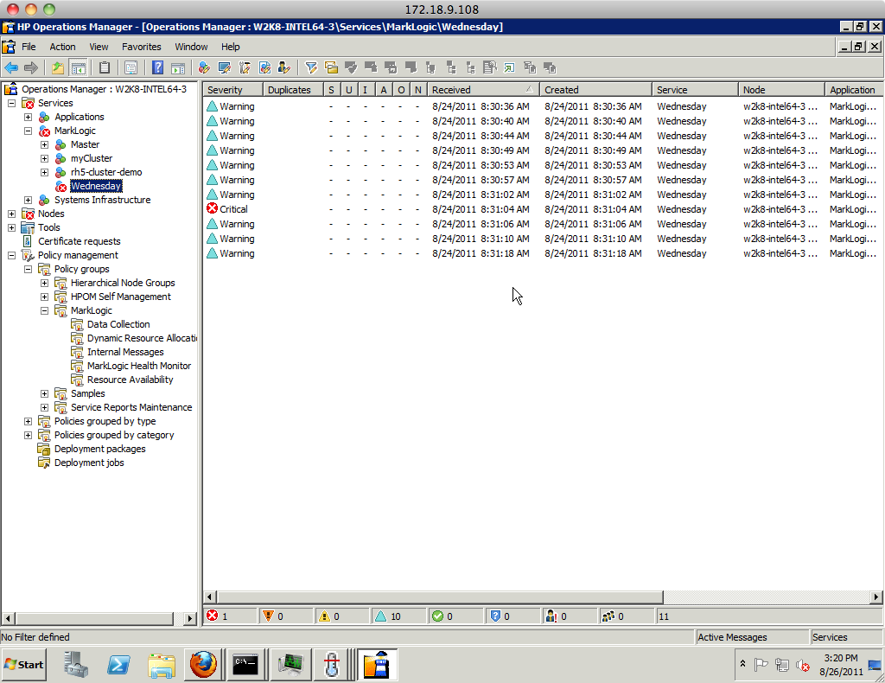
Smart Plug-In for HPOM

Slide 18
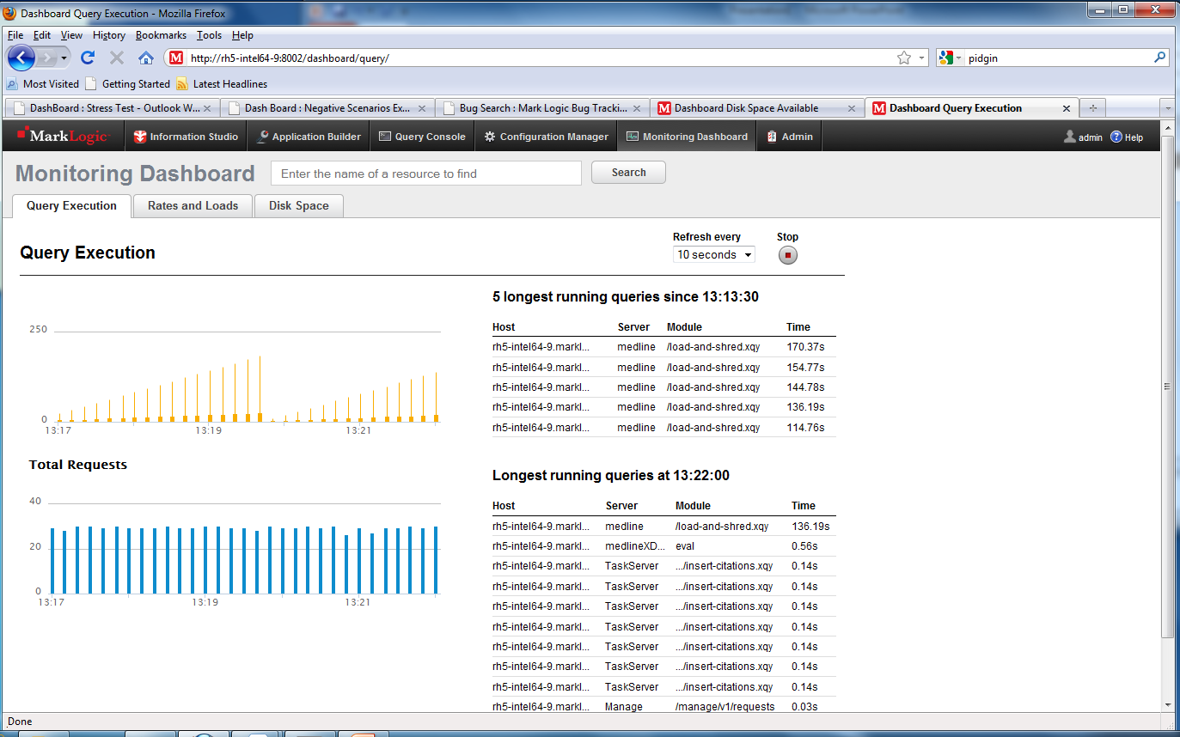
Dashboard: Requests

Slide 19
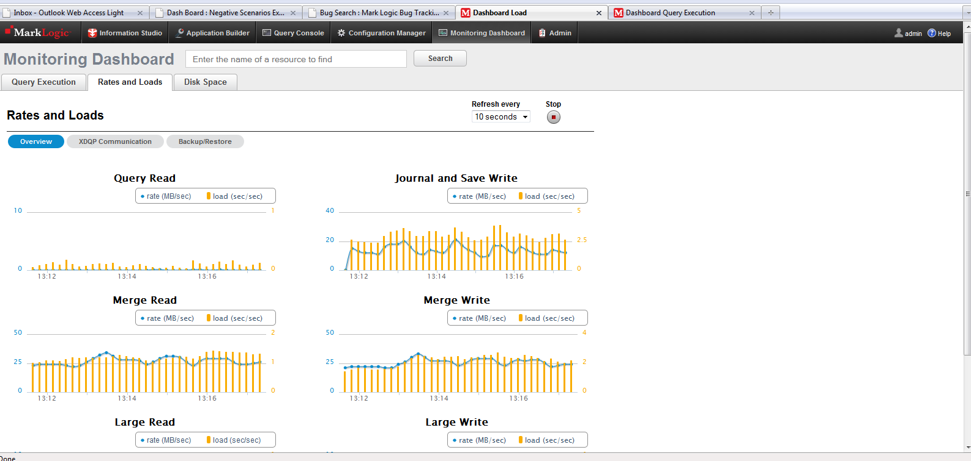
Dashboard: Rates and Loads

Slide 20
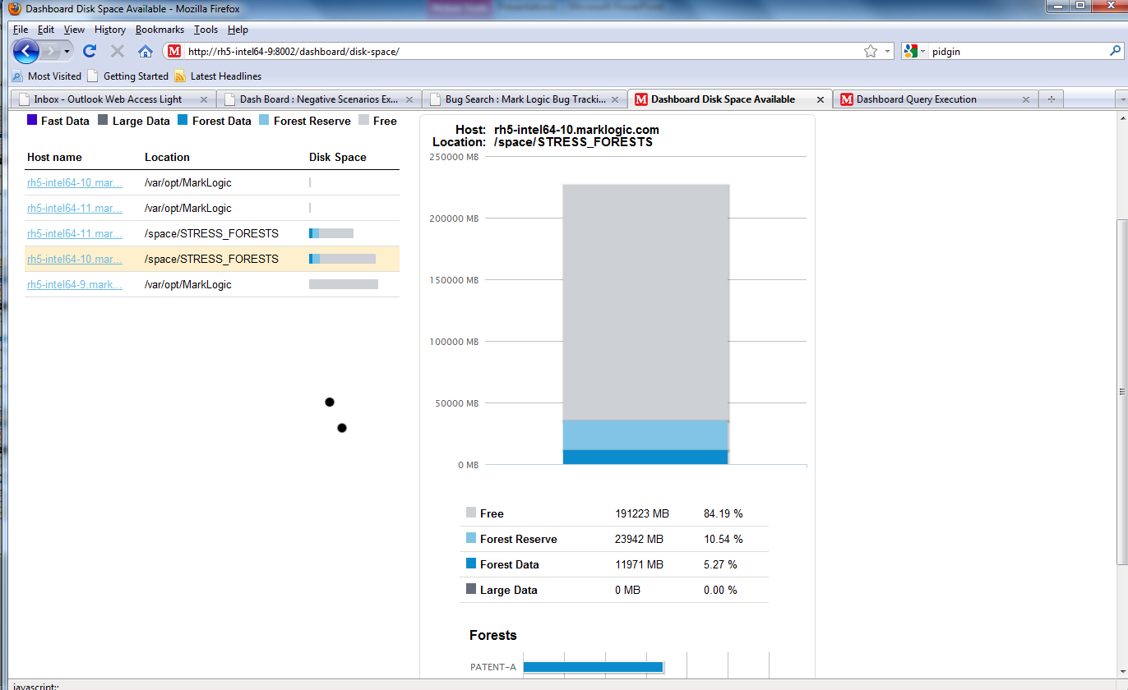
Dashboard: Disk Space

Slide 21
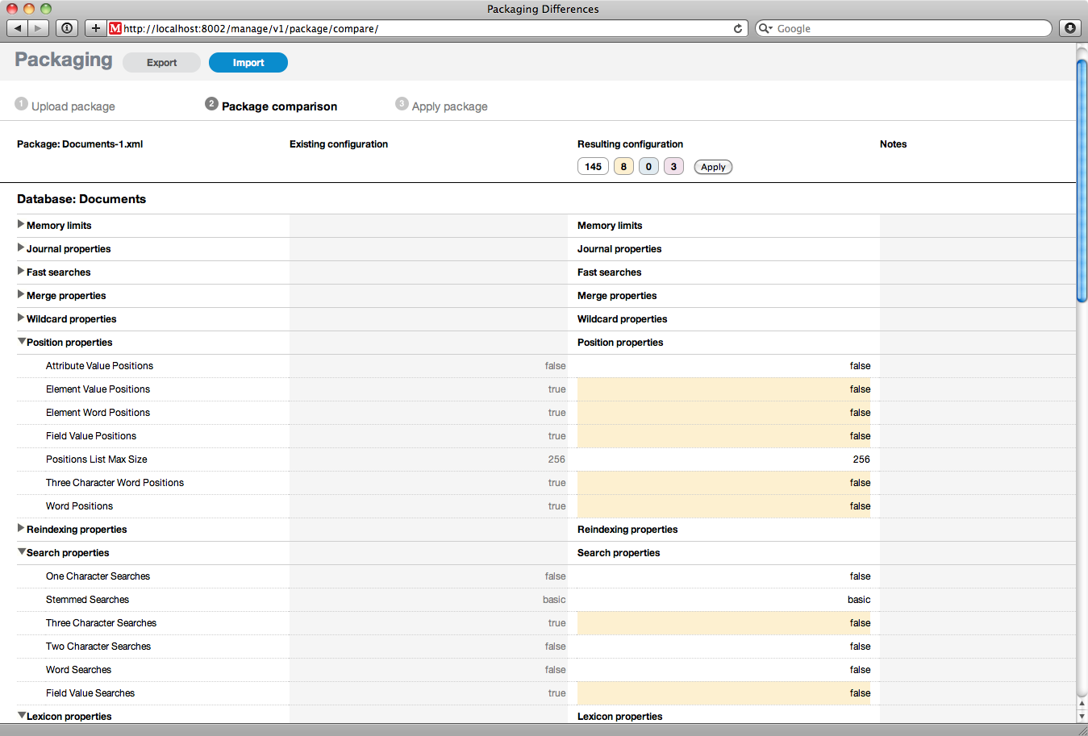
Package Comparison

Slide 22
Managing Complexity
Rich Media Support
Document Filters
Hadoop connector

Slide 23
Rich Media Support
Simplifies system architecture by consolidating rich media with textual data into single repository
Add enterprise robustness to rich media
Key features
No practical file size limitations
Enables streaming of audio/video files in the database
Optimized disk storage of rich media in database
Fast, cached storage of frequently used rich media files

Slide 24
Document Filters
Extends MarkLogic capabilities to binary formats, enabling analysis of rich media
Key features
Support for over 200 document and rich media formats
Identify the file type
Extract metadata
Extract text

Slide 25
MarkLogic Connector for Hadoop
MarkLogic 5 integrates with Hadoop for large scale batch processing
MarkLogic customers with sophisticated ETL requirements
Sub-select data of interest to load in MarkLogic for real-time analysis
MarkLogic customers with progressive enhancement needs
Enrichment: entity extraction, link analysis
Extraction: facial recognition, video/audio transcription, metadata
Statistical modeling: predictive analysis, recommendations
Text analytics: summarization, clustering, translation, weighting

Slide 26
MarkLogic Connector for Hadoop
Key points
Interoperates with Hadoop tools (development, monitoring)
A Hadoop API for MarkLogic, uses your MapReduce code
Run Hadoop MapReduce on data in MarkLogic
Uses standard Hadoop APIs
Drop-in installation

Slide 27
MarkLogic Express
New License for Software Developers
Usable in production environments
Includes
Single 2 CPU node, no cluster
Single developer (no teams)
Single application
40 GB of data
Alerting and geo-spatial

Slide 28
Appendix
Notes:
28

Slide 29
Awards

