Slide 1
Revolutionizing Application Performance by Eliminating I/O Wait Times

Slide 2
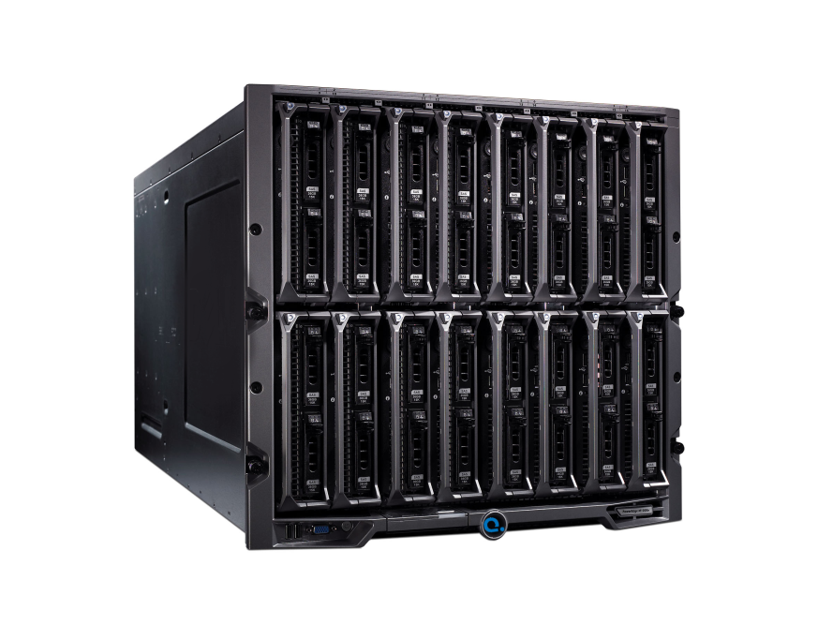
Kaminario K2
DRAM Block Storage Appliance
Delivering 2x to 25x application performance improvement

Slide 3
Challenge
80% of applications performance challenges – I/O
Business Suffers
- Productivity
- Operational Overhead
- Customer Satisfaction

Slide 4
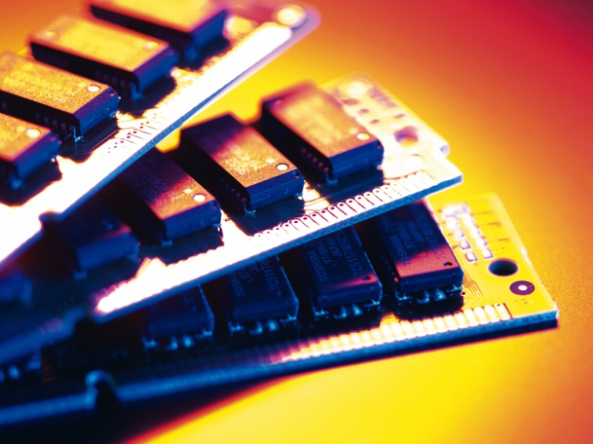
DRAM-Based Storage
Fastest!
DRAM is the fastest storage media
Much faster than FLASH
Stable Performance
For ANY workload – Random or Sequential
Consistent Performance
Not affected by used capacity nor over time
Reliable
The Solution: Kaminario K2

Slide 5
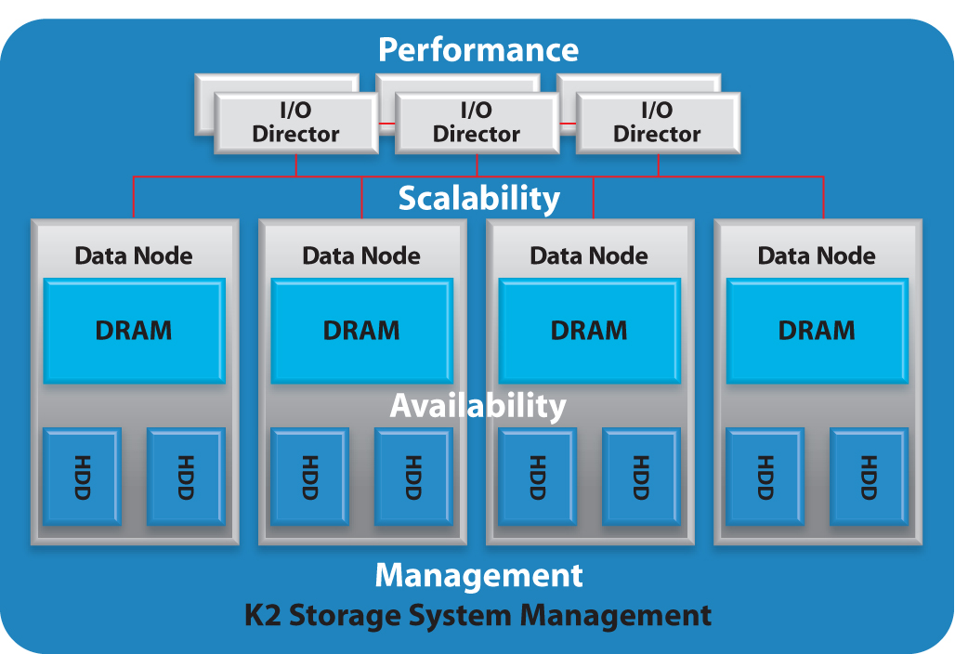
Scale-Out Performance Architecture (SPEAR)

Slide 6
The Kaminario K2
Performance
High Availability
Any workload
Easy
Scalable
Internal mirrored backup availability
Highest performance
No single point of failure
Quick implementation
Scale performance or capacity independently
No tuning
Start small and grow
Consistent performance
A Complete Offering

Slide 7
The Results are Impressive
Telco – Billing Queries
102 minutes query down to 1.2 minutes
Credit card – Marketing Analysis – SAS
181 minutes report down to 4.5 minutes
Products Fortune 10 – Product Simulation
21 minutes process down to 1 minute
Government – Real Time Data Mining
15 minutes free files text search down to 0.6 minute

Slide 8
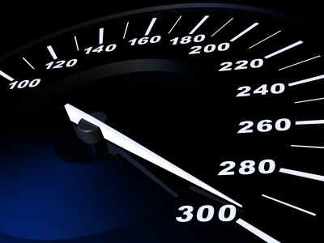
Businesses of all sizes have one thing in common…..
A critical application where extreme performance is everything!

Slide 9
Thank You

