Slide 1
Supercharging Analytics on Big Data Announcing 1000+ MapReduce-ready Advanced Analytic Functions June 21st. 2010

Slide 2
Aster Data’s Solution A Data-Analytics Server for Big Data Management
A highly-scalable MPP database running on commodity hardware
Integrated analytics engine, that uniquely leverages MapReduce for rich, scalable big data analytics
Rich, advanced analytics on large data volumes

Slide 3
Examples of Advanced Analytic Applications
Federal
Cyber defense
Fraud analysis
Watch list analysis
Internet / Social Media
User behavioral analysis
Graph analysis
Pattern analysis
Context-based click-stream analysis
Telecommunications
Service personalization
Call Data Record (CDR) analysis
Network analysis
Common Use Cases
Forecasting
Modeling
Customer segmentation
Clickstream analysis
Retail
Packaging optimization
Consumer buying patterns
Advertising and attribution analysis
Financial Services and Insurance
Credit and risk analysis
Value at risk calculation
Fraud analysis

Slide 4
What all these Applications have in Common
Federal
Cyber defense
Fraud analysis
Watch list analysis
Internet / Social Media
User behavioral analysis
Graph analysis
Pattern analysis
Context-based click-stream analysis
Telecommunications
Service personalization
Call Data Record (CDR) analysis
Network analysis
Speed
Frequent analysis of all data with insights in seconds/minutes
Common Use Cases
Forecasting
Modeling
Customer segmentation
Clickstream analysis
Scale
Analysis that must scale to terabytes to petabytes of data
Retail
Packaging optimization
Consumer buying patterns
Advertising and attribution analysis
Financial Services and Insurance
Credit and risk analysis
Value at risk calculation
Fraud analysis
Richness
Deep data exploration
Ad hoc, interactive analysis rather than simple reports

Slide 5
Aster Data: Big Data Analytics & Bringing MapReduce to the Enterprise
Automatic Parallelization
Automatically parallelizes applications using Aster’s integrated analytics engines and SQL-MapReduce
Parallelization is key for processing large volumes of data
100% Processing In-database
100% of analytics processing runs in-database, so processing is co-located with data
Eliminates need for massive data movement
Extensive Suite of Ready Functions
Extensive suite of pre-built advanced analytics functions that are MapReduce-enabled, e.g. time-series, clustering, graph, market basket etc.
Easily Useable by Business Analysts
Ultra-simple formulation of advanced queries by coupling SQL with MapReduce
Brings the power of MapReduce to any business analyst with SQL skills

Slide 6
New: Expanded Suite of MapReduce-ready Analytics Totaling 1000+ Functions
NEW
Business Analyst Ready: 30+ SQL-MapReduce functions, fully parallelized and available as part of ‘Aster Analytic Foundation’ library
Example Functions include:
Text processing
k-Means cluster analysis
Unpack data transformations
Power User Functions: 40+ MapReduce-ready, automatically parallelized packages with 1000+ functions, available in java or C
All functions are available in native languages without learning curve of a separate procedural language
Example Functions include:
Monte Carlo simulation
Histograms
Linear algebra
Statistics
NEW

Slide 7
Aster Data Analytic Foundation (1 of 2) Examples of Business-Ready SQL-MapReduce Functions
Modules | Select Examples of Delivered, Business-ready SQL-MapReduce Functions
Path Analysis Discover patterns in rows of sequential data | nPath: complex sequential analysis for time series analysis and behavioral pattern analysis Sessionization: identifies sessions from time series data in a single pass over the data
Statistical Analysis High-performance processing of common statistical calculations | Correlation: calculation that characterizes the strength of the relation between different columns Regression: performs linear or logistic regression between an output variable and a set of input variables
Relational Analysis Discover important relationships among data | Basket analysis: creates configurable groupings of related items from transaction records in single pass Graph analysis: finds shortest path from a distinct node to all other nodes in a graph

Slide 8
Aster Data Analytic Foundation (2 of 2) Examples of Business-Ready SQL-MapReduce Functions
Modules | Select Examples of Delivered, Business-ready SQL-MapReduce Functions
Text Analysis Derive patterns in textual data | Text Processing: counts occurrences of words, identifies roots, & tracks relative positions of words & multi-word phrases Text Partition: analyzes text data over multiple rows
Cluster Analysis Discover natural groupings of data points | k-Means: clusters data into a specified number of groupings Minhash: buckets highly-dimensional items for cluster analysis
Data Transformation Transform data for more advanced analysis | Unpack: extracts nested data for further analysis Multicase: case statement that supports row match for multiple cases

Slide 9
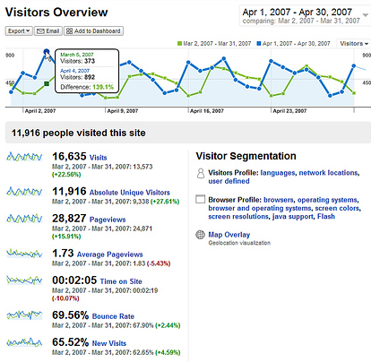
Example: nPath Function for time-series analysis
Uncovering patterns in sequential steps
What this gives you:
- Pattern detection via single pass over data
Allows you to understand any trend that needs to be analyzed over a continuous period of time
Example use cases:
- Web analytics– clickstream, golden path
- Telephone calling patterns
- Stock market trading sequences
nPath in Use: Marketing Attribution
Complete Aster Data Application:
Sessionization required to prepare data for path analysis
nPath identifies marketing touches that drove revenue

Slide 10
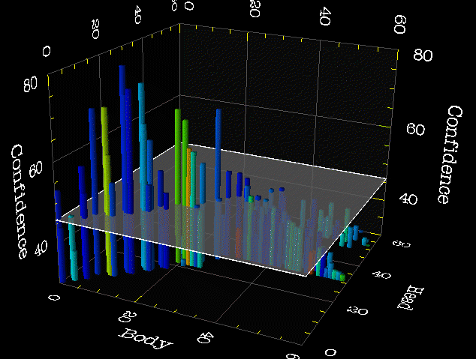
Example: Basket Generator Function
Extensible market basket analysis
What this gives you?
Creates groupings of related items via single pass over data
Allows you to increase or decrease basket size with a single parameter change
Example use cases:
Retail market basket analysis
People who bought x also bought y
Basket Generator in Use
Complete Aster Data Application:
Evaluate effectiveness of marketing programs
Launch customer recommendations feature
Evaluate and improve product placement

Slide 11
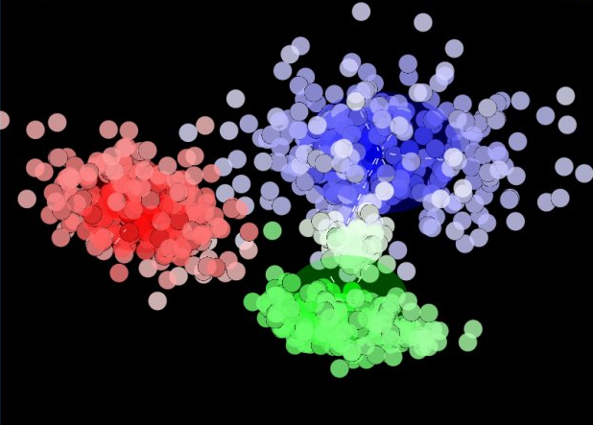
Example: k-Means Function
One call for clustering items into natural segments
K-Means in Use: Contact Center
What this gives you:
Organizes data into groupings or clusters based on shared attributes
Allows you to understand natural segments
Example use cases:
Marketing segmentation
Fraud detection
Computer vision-- object recognition
Complete Aster Data Application:
Text processing required to prepare data for customer support analysis
K-Means identifies hot product issues for proactive response

Slide 12
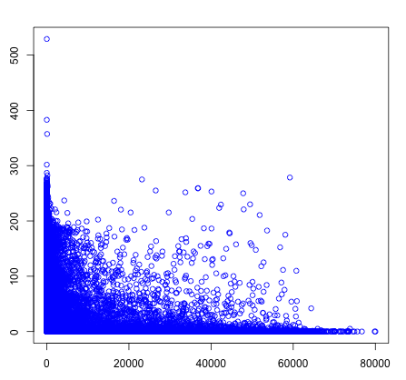
Example: Unpack Function
Transforming hidden data into analyst accessible columns
Unpack in Use: Pricing Analysis
What this gives you:
Translates unstructured data from a single field into multiple structured columns
Allows business analysts access to data with standard SQL queries
Example use cases:
Sales data
Stock transaction logs
Gaming play logs
Complete Aster Data Application:
Text processing required to transform/unpack third party sales data
Sessionization required to prepare data for path analysis
Statistical analysis of pricing

Slide 13
PLUS – Announcing Additional Partners
NEW
4 New analytic application development partners building on Aster Data nCluster
Fuzzy Logix
In-database quantitative library DB Lytix™, including mathematical and statistical methods, data mining algorithms and Monte Carlo simulation techniques
Cobi Systems
End-to-end analytic applications across financial services and retail
Impetus
Big data management applications integrating Aster Data nCluster and Hadoop
Ermas Consulting
In-database SAS and R applications

Slide 14
Aster Data & Fuzzy Logix: Advancing In-Database Analytics on Big Data
Large Data Volume
Fast Processing
High Accuracy
Balancing between large volumes of data, throughput and accuracy has always been a challenge- typically sacrifice one or more of these for practical considerations.
Fuzzy Logix is providing an analytical platform on Aster Data nCluster using SQL-MR wherein one can achieve all these three objectives simultaneously.
Traditional constraints of data analysis are almost non-existent in this platform.
Powered by in-database analytics on Aster Data nCluster

Slide 15
Introducing DB Lytix™ on Aster Data nCluster Runs In-database & Uses SQL-MapReduce for high performance analytics on big data volumes
“DB Lytix is the most noteworthy in-database analytics tool” Forrester Report, Nov 2009
Analytical Functions in DB Lytix
Mathematical
Probability Distributions
Basic math
Matrix Algebra
Area under curve
Interpolation methods
Statistical
Descriptive statistics
Distance measures
Hypothesis testing
Gamma and Beta functions
Chi-Square & Contingency Tables
Support Vector Machines
Cluster analysis - 5 models available
Principal component analysis (PCA)
Logistic regression
Linear regression
Data Mining
ANOVA
Monte Carlo Simulation
Univariate distributions
Copulas - Correlated Multivariate distributions

Slide 16
Aster Data – Big Data Management & Analytics
Highly scalable massively parallel DBMS
Stores & analyzes TB’s to PB’s of data
Runs on commodity servers with incremental scaling
Enables new class of analytics and data-rich applications
Notes:
[

